Slide 1
ELECTROMAGNETIC RADIATION
PERENTED BY
LEELAWATI PAIKRA

Slide 2
INTRODUCTION
Electromagnetic radiation refers to the waves
(their quanta,photons) of the electromagnetic field , propagating through space ,carrying electromagnetic radiant energy .
It includes radio waves ,micro waves, infrared,
visible light ,UV rays ,X-ray and gamma rays.All of these waves form part of the electromagnetic radiation.

Slide 3
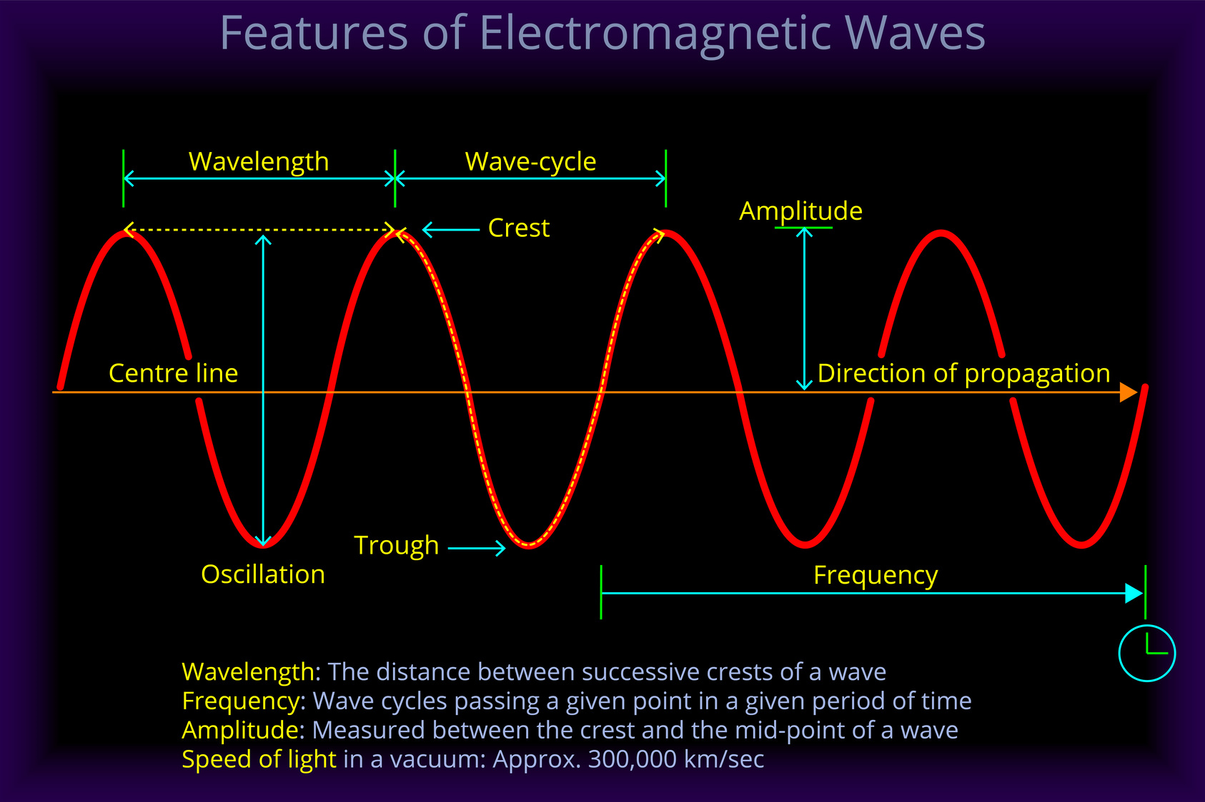
STRUCTURE

Slide 4
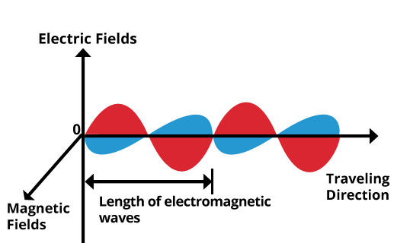

Slide 5
PROPERTIES OF ELECTROMAGNETIC RADIATION
1 They emit energy continuously in the form of radiation or waves.
2 All these waves travel with the speed of light.
3 No medium is required for the propagation of these waves .
4 When radiation interact with a substance,three types of events occur-
Reflaction,absorption transit .

Slide 6
THE ORDER OF INCREASING ENERGY OF ELECTROMAGNETIC RADIATION
Radio waves < micro waves < IR < visible < UV rays < X-rays < gamma rays < cosmic rays

Slide 7
THE ORDER OF INCREASING WAVELENGTH
Cosmic rays < gamma rays < X-rays < UV rays < visible rays < IR rays < micro waves < radio waves

Slide 8


